Slide 1
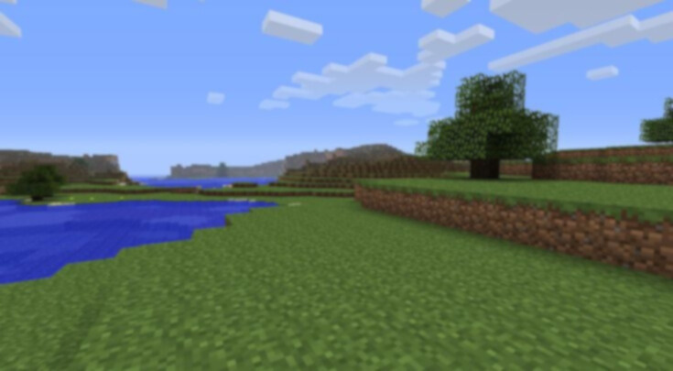


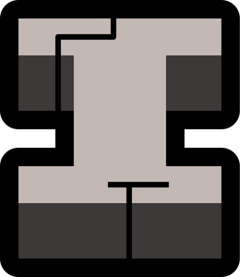
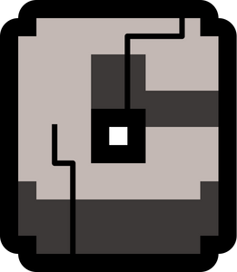
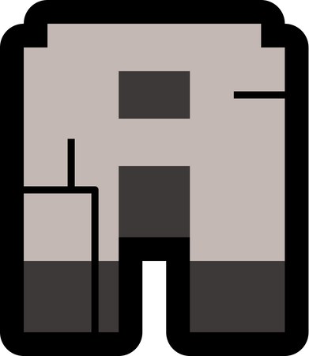
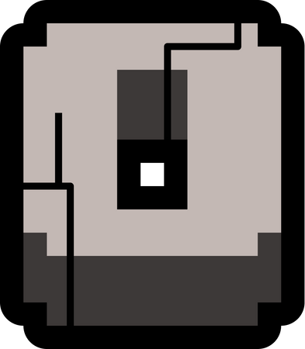
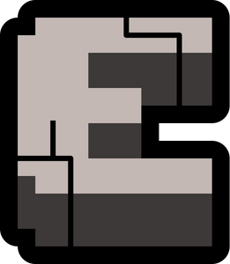
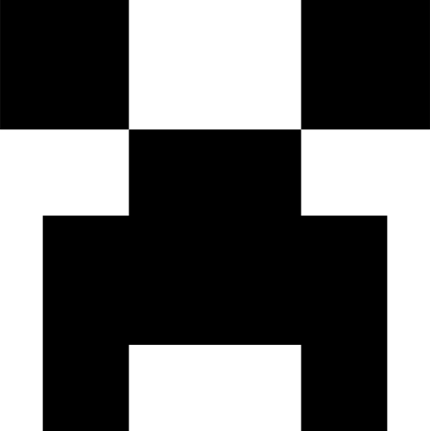


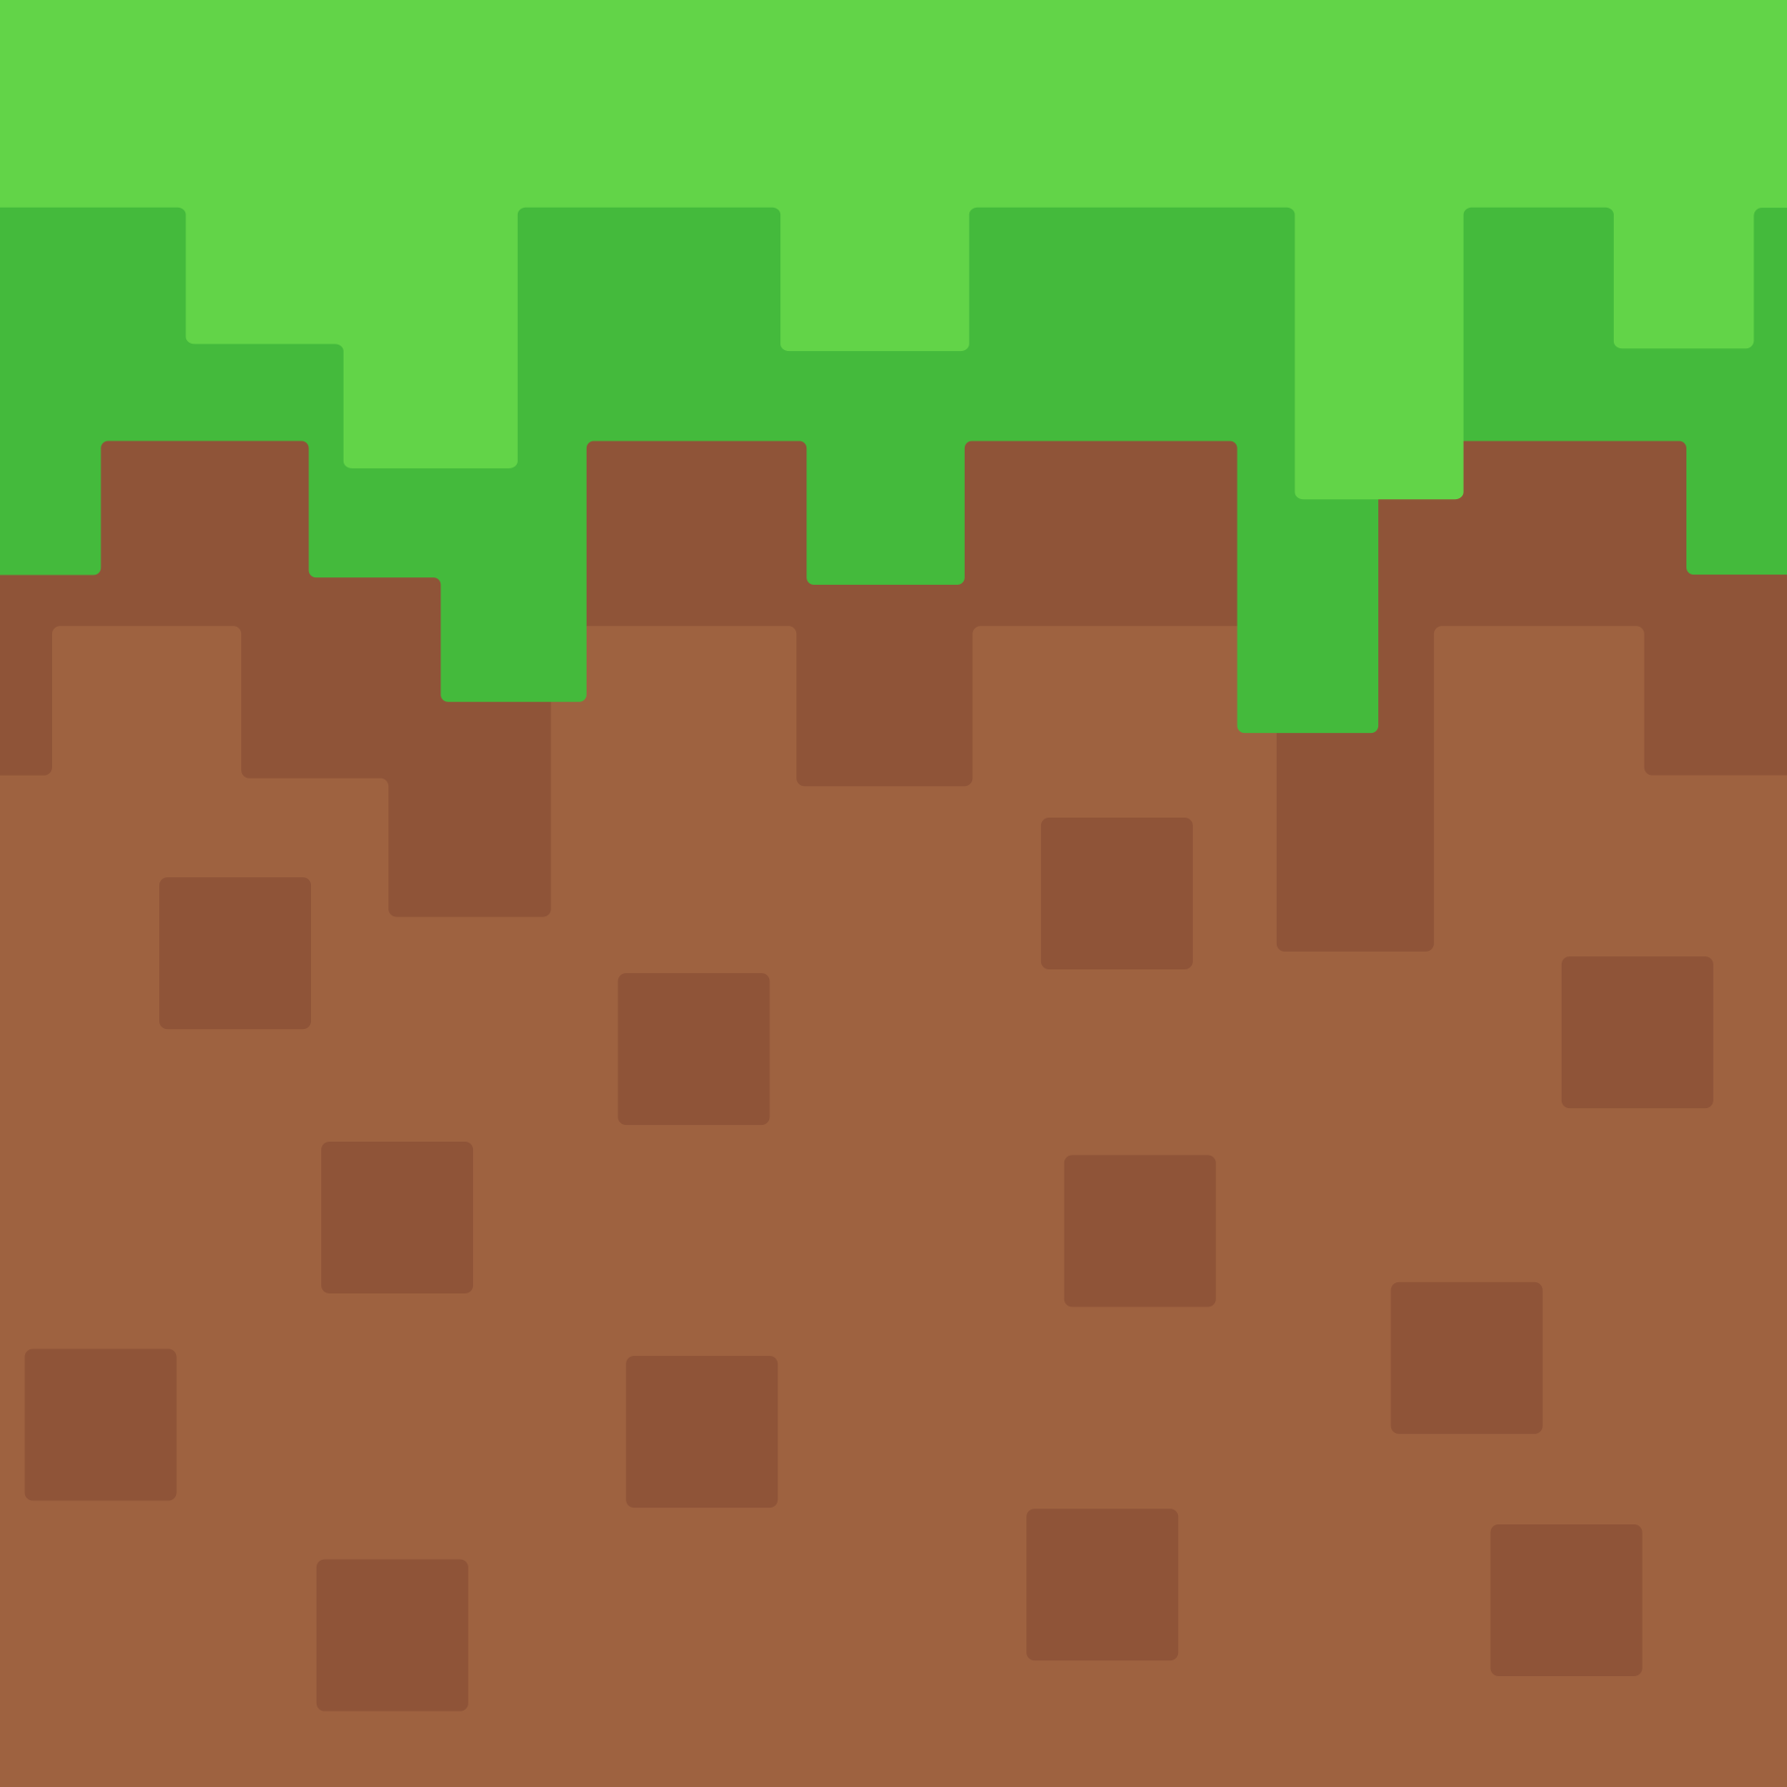

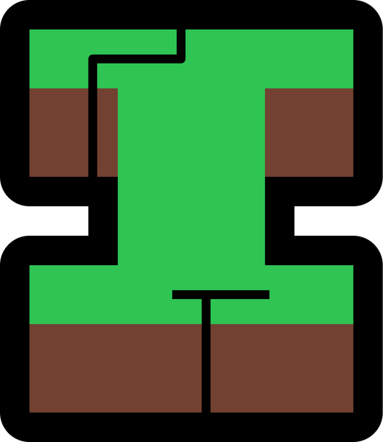
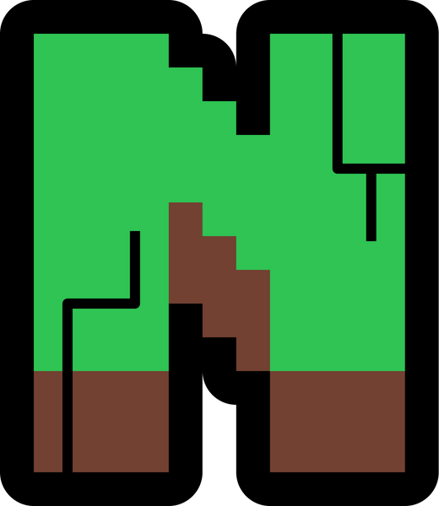
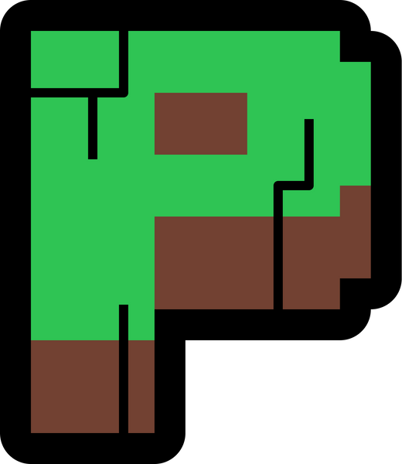
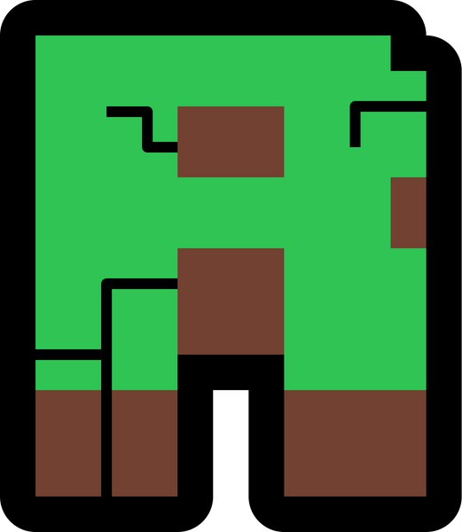
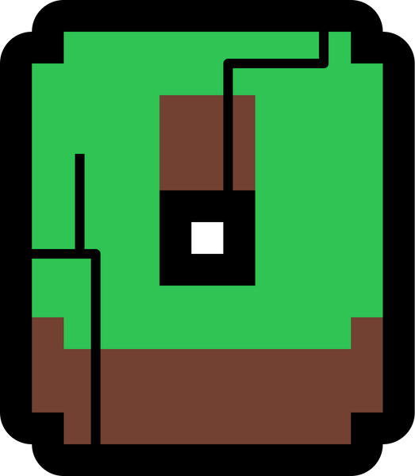
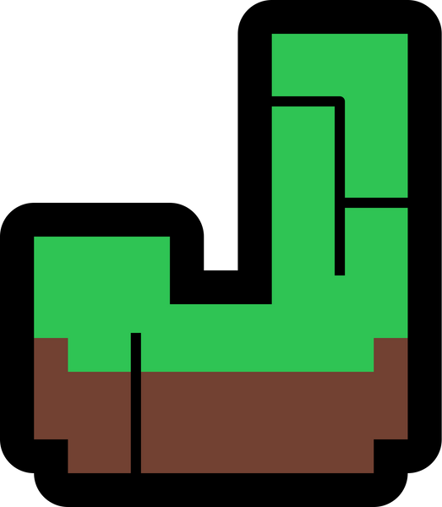
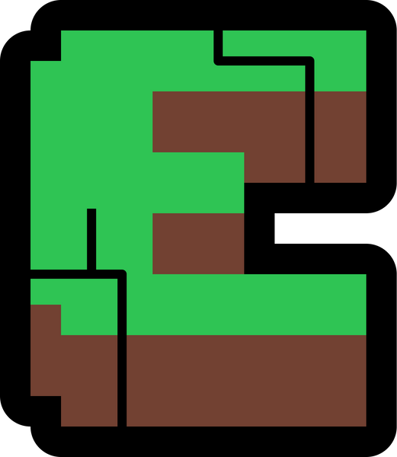
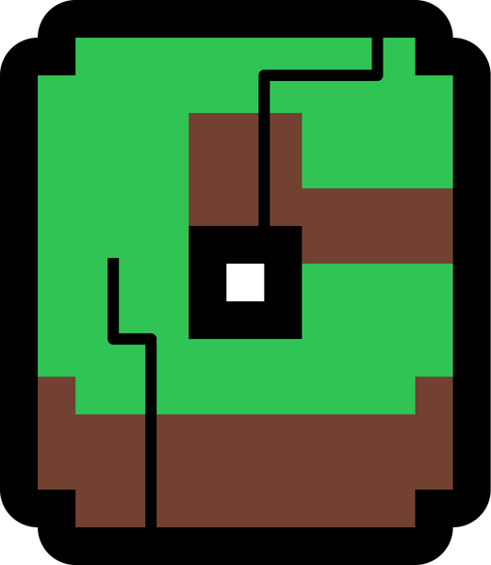
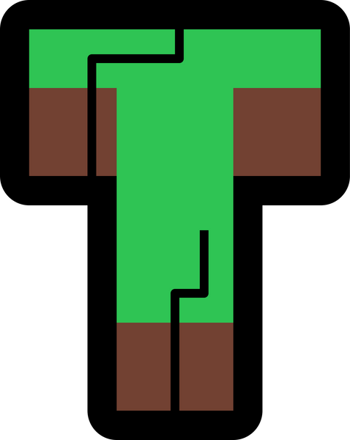

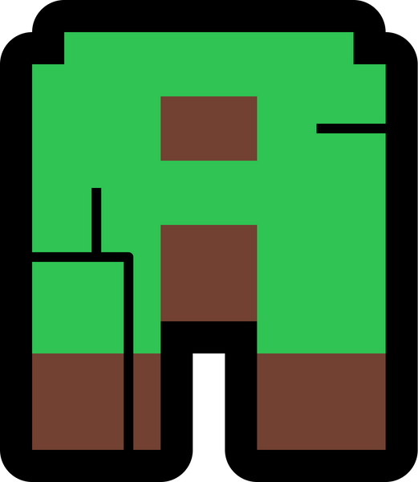


AI-POWERED
GAME
NAME -
MAY SHIN THANT
SRN -
23029352
START

Slide 2



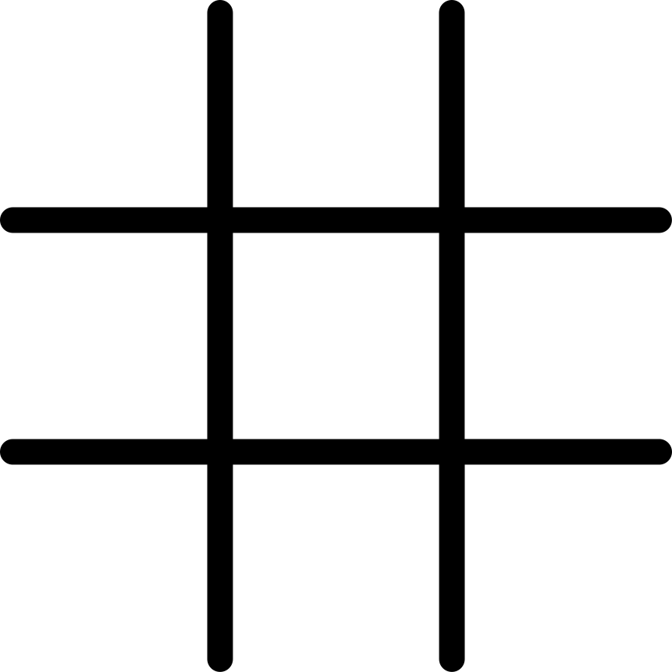

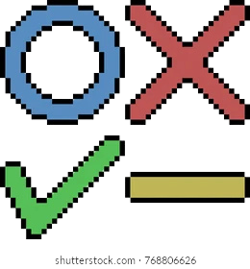

Introduction
OBJECTIVE
Game Concept
Evaluate and compare AI methods in a two-player game involving strategy and chance.
A Tic-Tac-Toe game where the player competes against an AI opponent of varying difficulty.
against

Slide 3
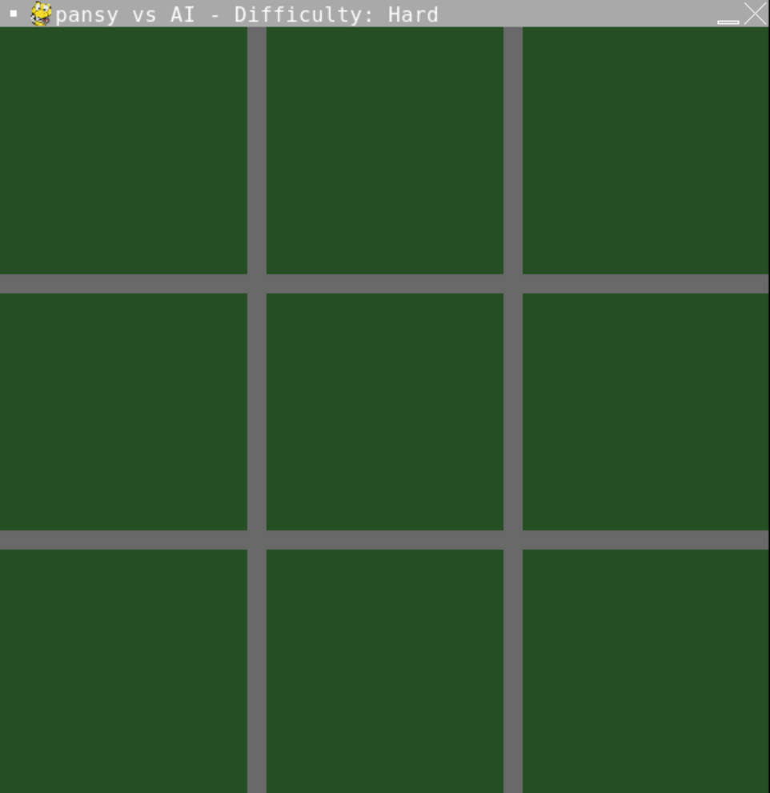

WIREFRAME
Game screen showing
the Tic-Tac-Toe grid
DIFFICULTY STATUS
USERNAME DISPLAY

Slide 4
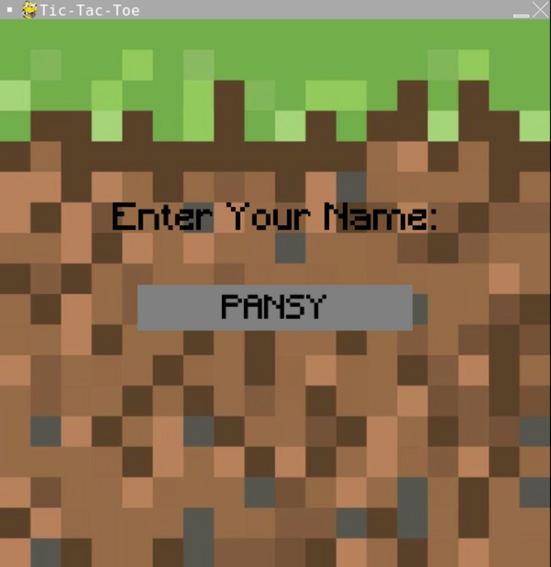
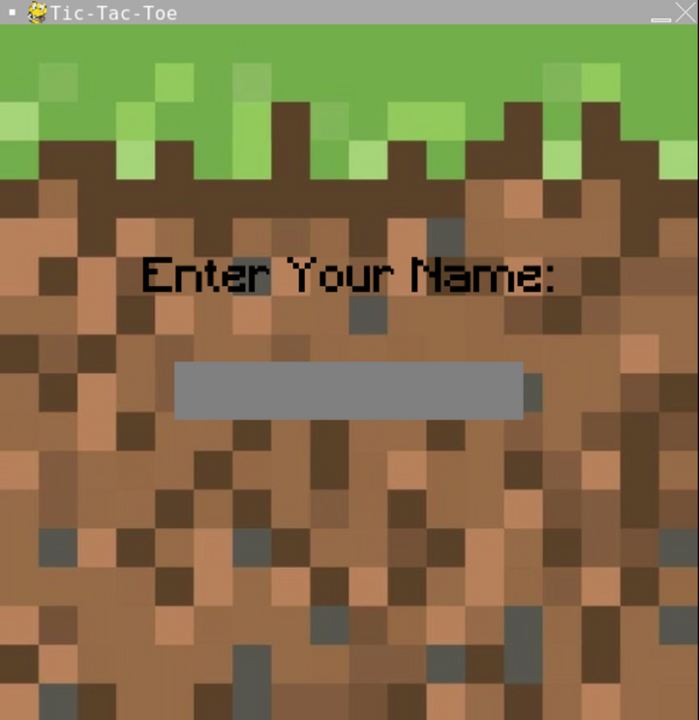
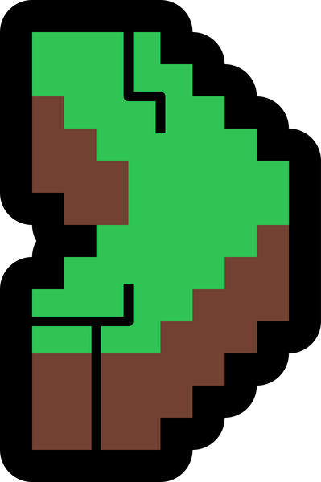
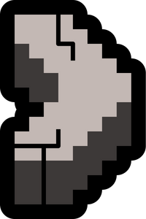
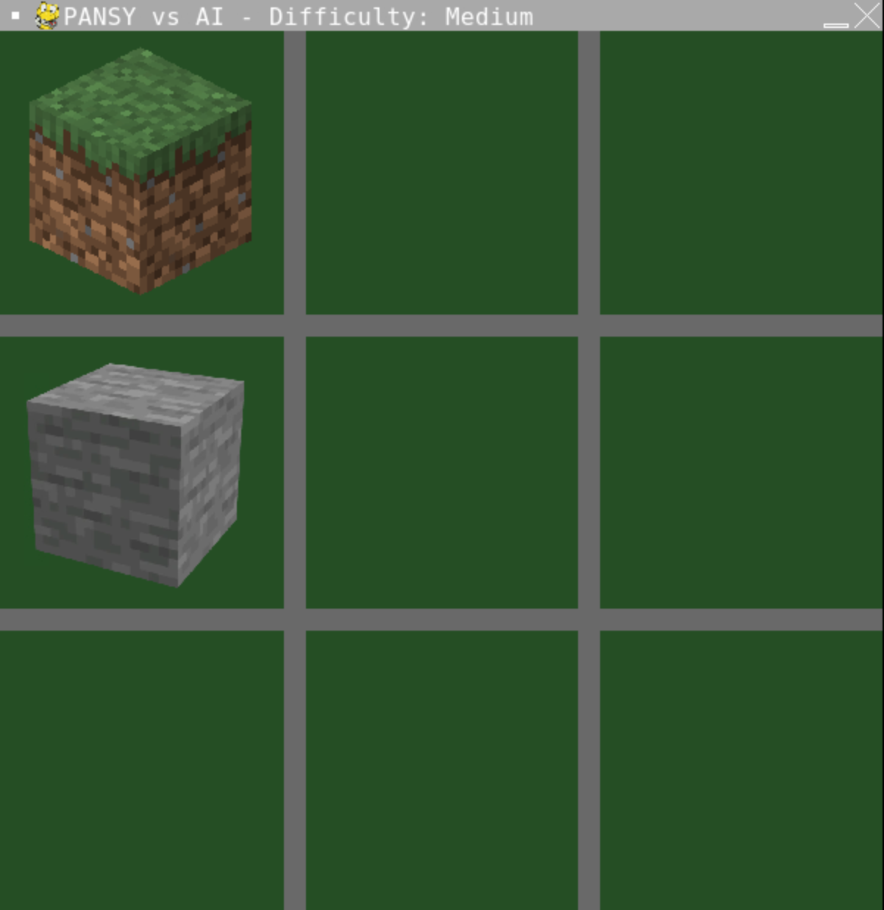
USERNAME INPUT
Dynamic game title with the entered username (e.g., "PANSY vs AI").
Game screen username input display

Slide 5
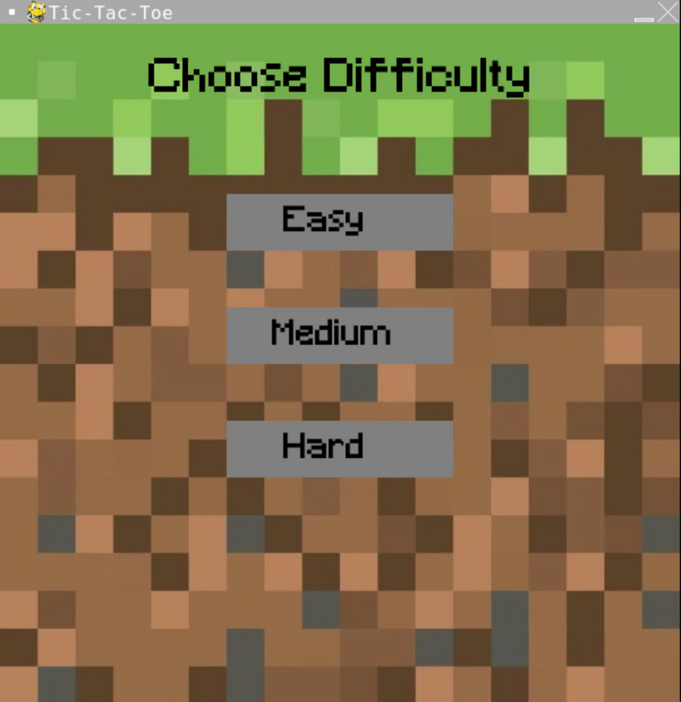
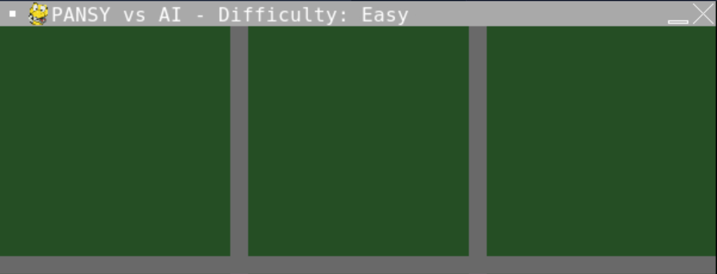
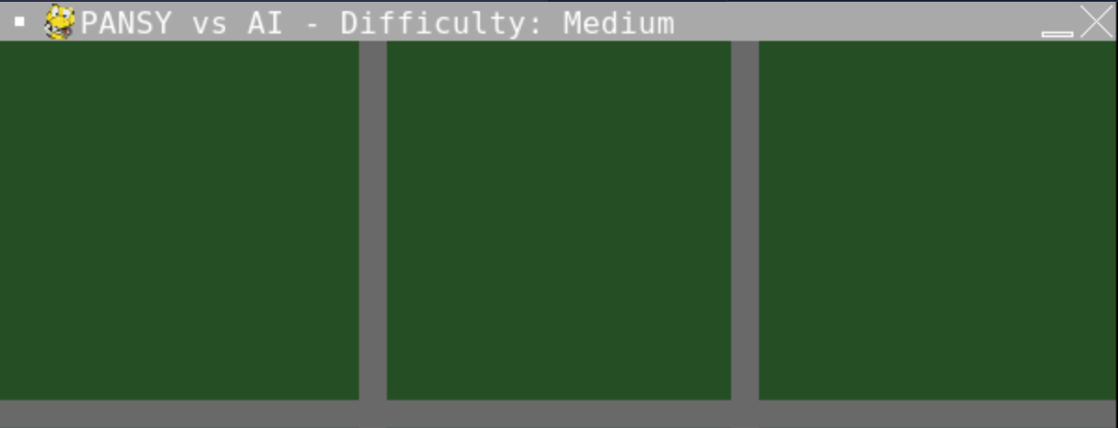

AI Difficulty Levels
MENU SCREEN
DIFFICULTY STATUS
Easy Mode:
Random moves by the AI.
MEDIUM Mode:
AI considers potential player-winning moves and blocks them.
HARD Mode:
AI uses the Minimax algorithm to play optimally and is unbeatable.

Slide 6
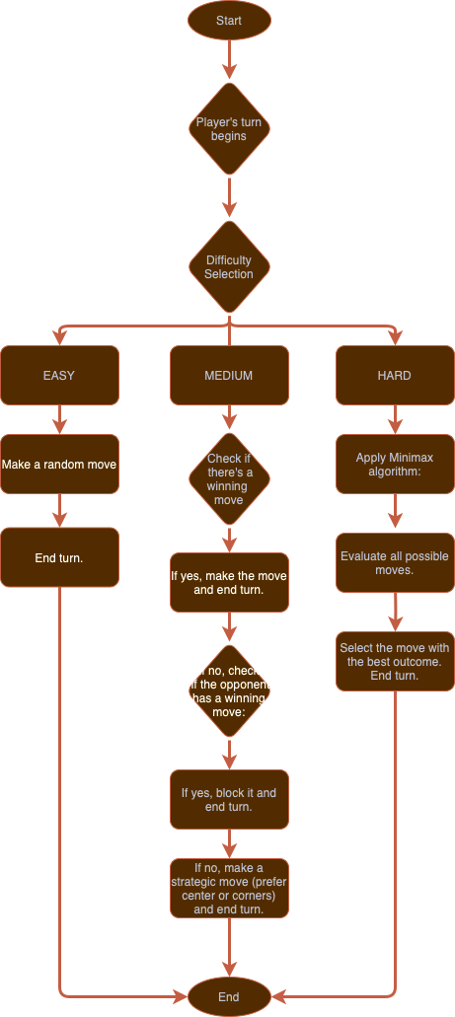
Beginning of the flowchart.
Player makes their move.
Decision-making point where the selected
difficulty is checked (Easy, Medium, or Hard).
AI Difficulty Levels
FLOWCHART

Slide 7
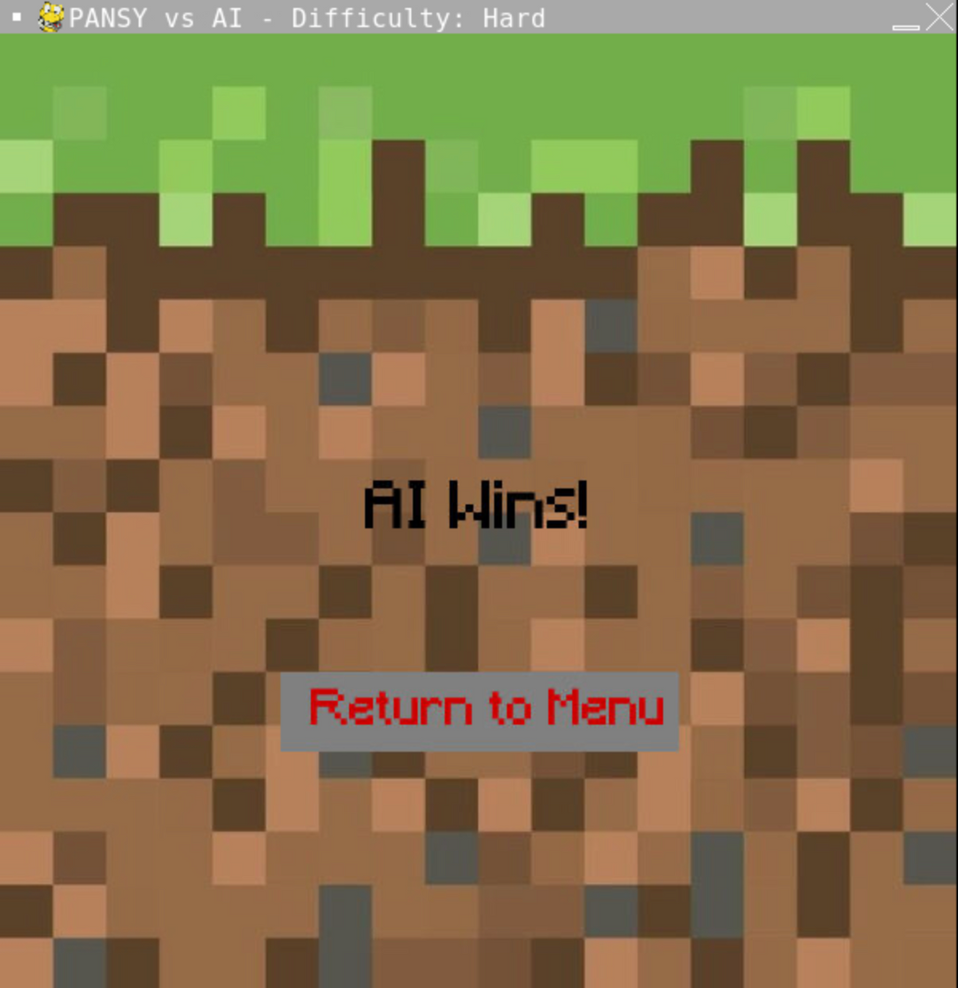
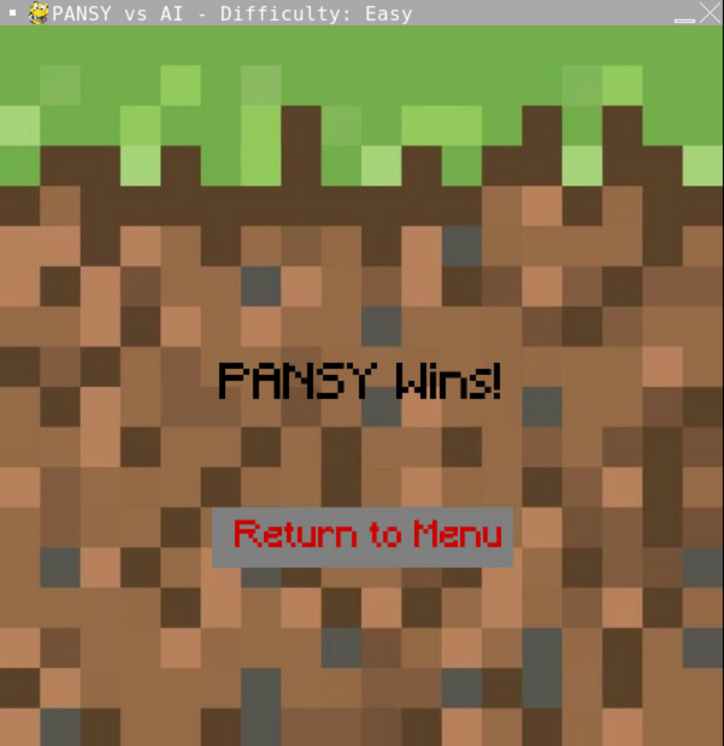
Key Features
Visual
Username Input
Game Features
Interactive Tic-Tac-Toe grid.
AI opponent with increasing difficulty levels.
Automatic board resetting after each round.
Back-to-menu button for replayability.

Slide 8
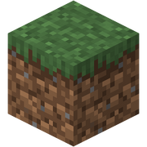
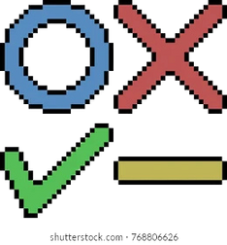
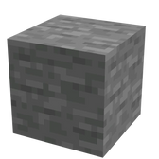
marks
player
AI

Slide 9
Challenges
Solutions
AchievementS
Future Work
Clear AI Behavior Differentiation.
Ensuring the game remains engaging across all levels.
Balancing user experience with AI complexity.
Developed three distinct AI level Rules
Used visual enhancements for better player engagement.
Successfully implemented a feature-rich AI-powered Tic-Tac-Toe game.
Explored contemporary AI techniques (Minimax,blocking strategies).
Extend the game to include multiplayer support or more advanced AI strategies.

Slide 10
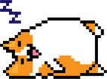
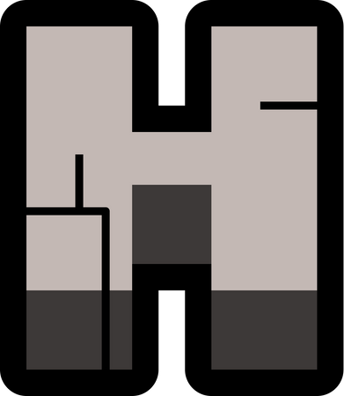
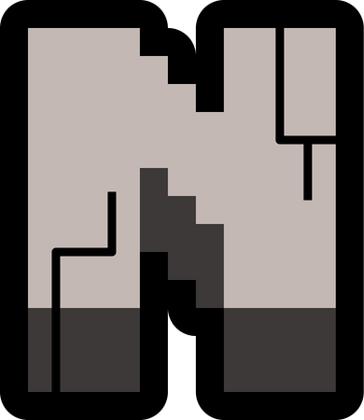
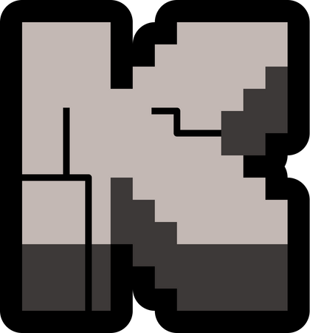
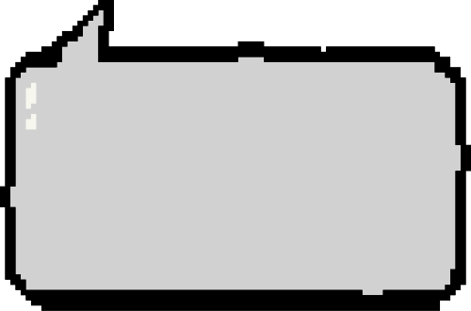




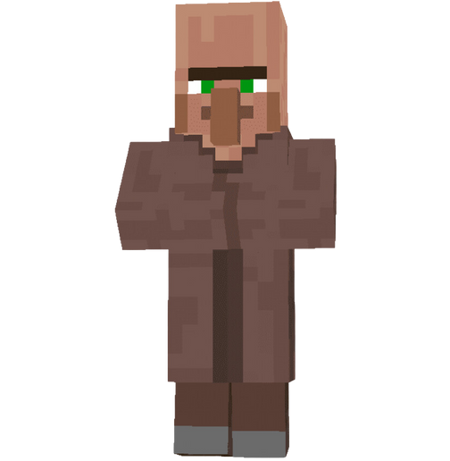

ANY QUESTIONS?
THE END

